Slide 1
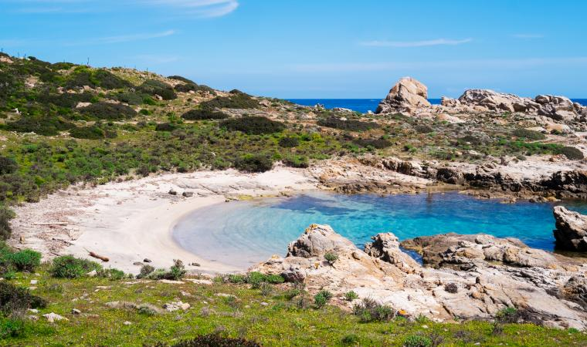
Tourism in North Sardinia
Can we take advantage of the moment to make tourism sector grow?

Slide 2

In this era of social distancing, could there be the opportunity to link famous and unknown areas for a mutual benefit?

Slide 3
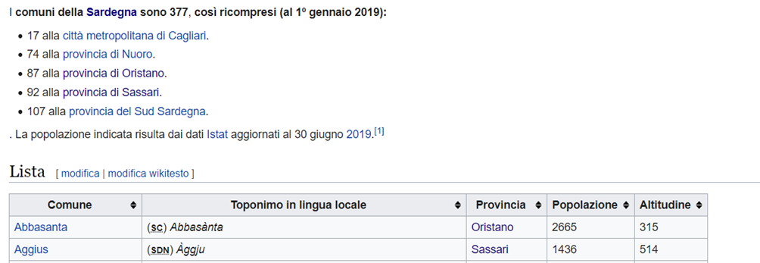
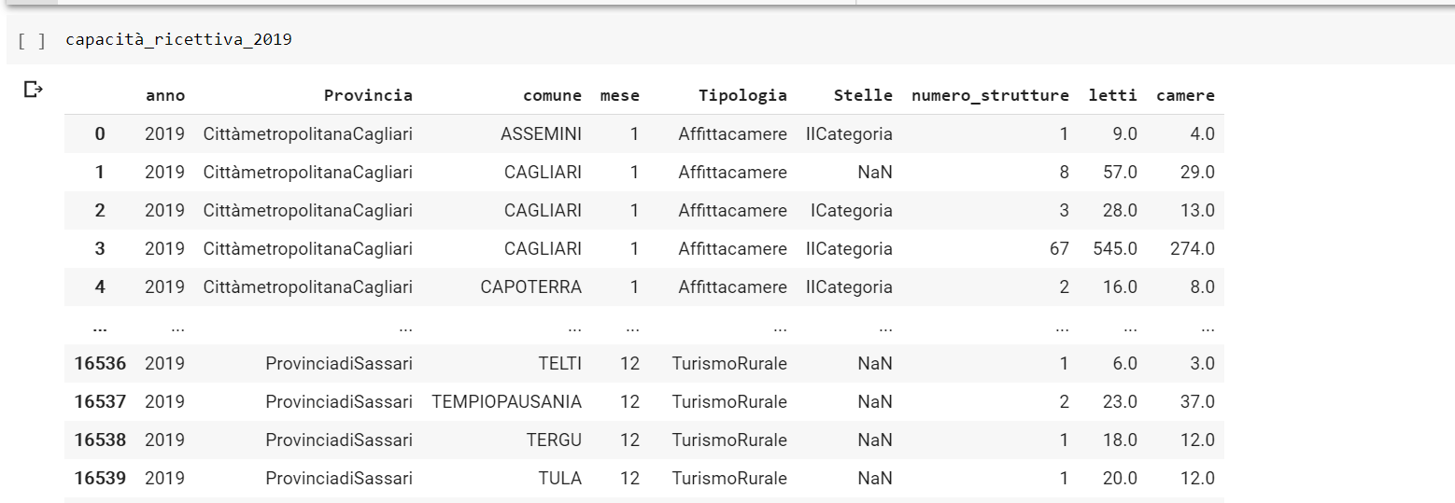
Starting from the data
Incoming tourist in Sardinia 2019 by cities
Sardinia 2019 accommodation capacity
The used methodology is to apply clustering analysis to three different dataset containing information about tourism in North Sardinia such as:
city venues, that should model the attractiveness of the place;
tourist accommodation facilities, that represents the hosting capacity;
tourists’ presences by nation of provenience, that segment customers.
Venues have been searched in a round of 1.5km from the city center, the analysis considered the most frequent ten categories for each municipality. The same limit has been used in the other investigations too.
With these results the analysis has followed by k-means method to compose the clusters. In every case the number of clusters has been 5.

Slide 4
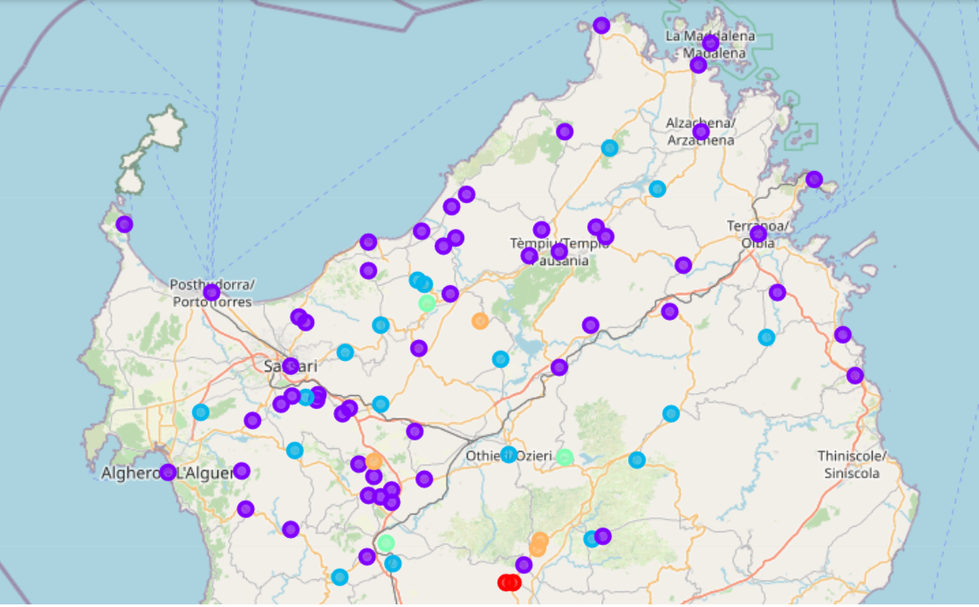
The five clusters obtained by the city venues analysis are:
Cluster 1, red label, composed by very small towns where venues are mainly dedicated to daily food provisioning;
Cluster 2, violet label, composed by the most part of the cities with a wide offer of leisure services and gourmet food;
Cluster 3, light blue label, where main activities regard small and medium enterprises and related services;
Cluster 4, orange label, characterized by agricultural economy and genuine country food;
Cluster 5, light green label, where activities are linked to everyday life and the most common venues are bar and café as social meeting point for the few citizens.

Slide 5
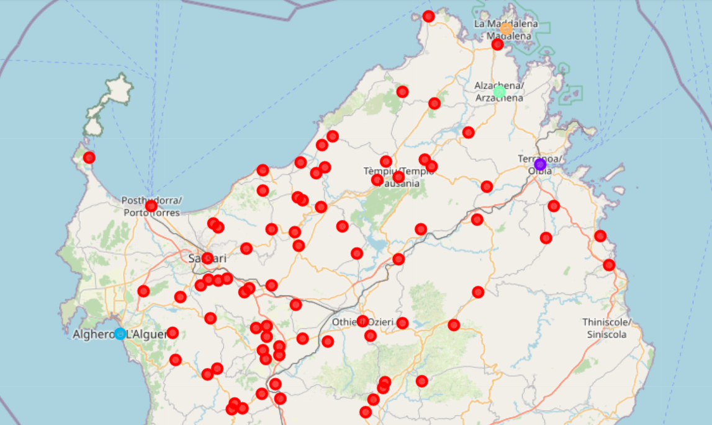
The five clusters obtained by the analysis of the tourist accommodation capacity are:
Cluster 1, red label, this is the cluster more populated and cities inside show common characteristics all over the area.
Other Clusters, they are composed by just one city each with Olbia (2, violet label) , Alghero (3, light blue label), Arzachena (4, light green label) e La Maddalena (5, orange label) are unique places that built up their touristic offer over decades. Most common facilities in Olbia are resorts, in Alghero are B&B and private holiday houses, in Arzachena are high level hotels and resorts and in La Maddalena medium level resorts.

Slide 6
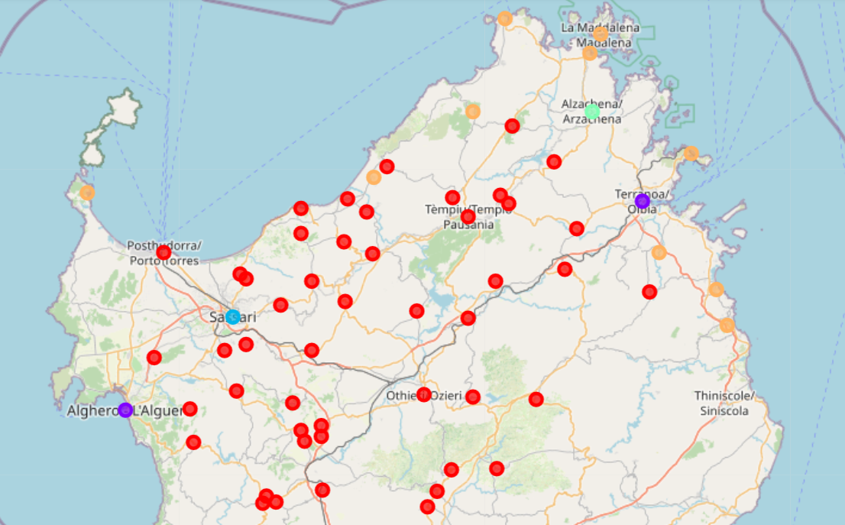
The five cluster by tourist’s nationality are:
Cluster 1, red label, we can find here inside cities with tourists coming from other part of the region, from Italy or from Europe.
Cluster 2, violet label, contains Alghero and Olbia that have very various tourists.
Cluster 3, light blue label, is Sassari where tourism is for business or immigration.
Cluster 4, light green label, with Arzachena and its Costa Smeralda, a very international attraction.
Cluster 5, orange label, the most interesting. There are only coastal cities, but not all, and their tourists’ nationalities are mainly Italian and European.

Slide 7

Comparing the three analyses can suggest possible strategies for development.
The main possible consideration derived by reading together the three maps is that, as well known, tourism in Sardinia is inseparably linked to its coasts but there is still room for development in the North coast where some cities with attractive venues and accommodation can aspire to reach the same, and more remunerative, tourist segment as the other coastal cities.
This can be a favorable finding to use now in the phasing out from the Covid crisis. Social distancing push to spread presence and these cities can be a good alternative to more crowded seaside.

Slide 8
Thank you for your attention

